Slide 1


Welcome to Medicare
Julie Fick, Elder Benefit Specialist
ADRC of Buffalo & Pepin Counties
April 13th, 2021
Notes:
Good Morning. My name is Julie Fick, I am an Elder Benefit Specialist with the Aging Disability Resource Center (which also known as the ADRC) of Buffalo & Pepin Counties. Today’s Welcome to Medicare program will provide an overview of Medicare.

Slide 2
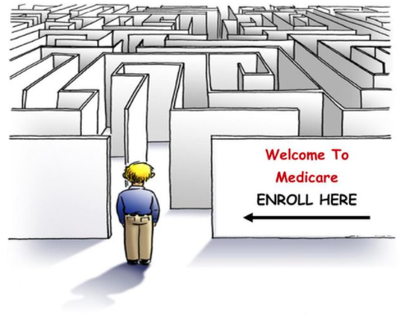
Notes:
So I’ll start with a picture that I think represents how many people that I meet with feel about Medicare So here we have poor Peter, who is standing outside of an office entrance. He is new to Medicare and after talking with a friend, recommended that he schedule an appointment with the ADRC to review some of his options. Peter is all alone not sure where to begin so he pauses for a moment & takes a deep breath. What he really wants to do is turn around and walk back to his car and drive away as fast as he can.. in his mind he will try again another day!
With Medicare’s many coverage options it’s no wonder why people (like Peter) don’t know where to begin! It’s no surprise that many Medicare beneficiaries are unsure if they have adequate coverage or even what type of coverages are available to them.
Hopefully, I will be able to help things seem a little less confusing and overwhelming with today’s presentation.

Slide 3

Presentation Outline
Enrollment in Medicare
Medicare Basics
Your Coverage Choices
SeniorCare
Help for People with Limited Income
Words of Caution
Find more detailed information in your Medicare & You 2021 Handbook.
Notes:
During today’s presentation, we will review:
Enrollment in Medicare
Medicare Basics
Your Coverage Choices
Senior Care
Help for People with Limited Income
Words of Caution
The Medicare & You handbook pictured here is mailed to every Medicare household each year in the fall. Please refer to this handbook for further details.

Slide 4
What is Medicare
  Medicare is Health Insurance for three groups of people
  Age 65 or older
  Under age 65 with certain disabilities who are entitled to Social Security Disability
  Any age with End-Stage Renal Disease (permanent kidney failure requiring dialysis or a transplant)
Notes:
Read from slide

Slide 5
Enrollment in Medicare
Notes:
First we will start with Enrollment in Medicare

Slide 6
Enrollment in Medicare
If you already get benefits from Social Security or Railroad Retirement, you are automatically enrolled in Part A & B the first day of the month you turn 65.
If you are close to 65 but currently don’t receive Social Security benefits, you need to enroll in Part A & B with Social Security during your Initial Enrollment Period. (Next Slide.)
How to enroll:
  Visit socialsecurity.gov or
  Call Social Security at 1-800-772-1213
  Or for the local office: Eau Claire Field Office 1-866-815-2924
If you are under 65 and disabled, you are automatically enrolled in Medicare after receiving 24 consecutive months of SSDI.
Notes:
The first thing you will want to know about is how and when to enroll in Medicare.
If you already get benefits from Social Security or Railroad Retirement, you are automatically enrolled in Part A & B the first day of the month you turn 65.
If you are close to age 65 but currently do not receive Social Security benefits, you will need to enroll in Part A & B with Social Security during your Initial Enrollment Period.
To enroll:
Visit socialsecurity.gov or call Social Security directly at the numbers listed
If you are under age 65 and disabled, you are automatically enrolled in Medicare after receiving 24 consecutive months of Social Security Disability payments.

Slide 7
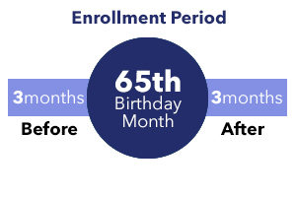
Enrollment in Medicare
Initial Enrollment Period
  7-month period includes 3 months before, month of, and
  3 months after 65th birthday.
Special Enrollment Period
  If you wait to enroll in Part B because you or your spouse are still working and have group health plan coverage, you can sign up during the 8 months following the month the group plan coverage ends OR employment ends (whichever is first). There will be no penalty.
General Enrollment Period
  January 1 through March 31. (For those who did not sign up during initial enrollment.) Penalty: Cost of Part B premium will go up 10% for each full 12-month period you delay enrolling. Coverage begins July 1.
Notes:
If you aren’t automatically enrolled into Medicare, Your first opportunity to enroll in Medicare is during your Initial Enrollment Period (aka IEP), which lasts 7 months. Your coverage starts based on when you enroll. If you enroll during the first 3 months of your IEP (the 3 months before the month you turn 65), your coverage will begin the first day of the month you turn 65.
There is also a Special Enrollment Period for enrollment into Medicare:
If you wait to enroll in Part B because you or your spouse are still working and have group health plan coverage, you can sign up during the 8 months following the month the group plan coverage ends OR when the employment ends (whichever is first). There will be no penalty.
Lastly, you can enroll in Medicare during what called the General Enrollment Period which is
January 1st through March 31st each calendar year. (This is only for those who did not sign up during their initial enrollment.) Unfortunately, they will have a Penalty: Cost of Part B premium will go up 10% for each full 12-month period you delay enrolling. Coverage begins July 1.
The main point to remember here is that if you are not receiving early retirement benefits, you should plan to enroll with Social Security about 3 months before you turn 65.

Slide 8
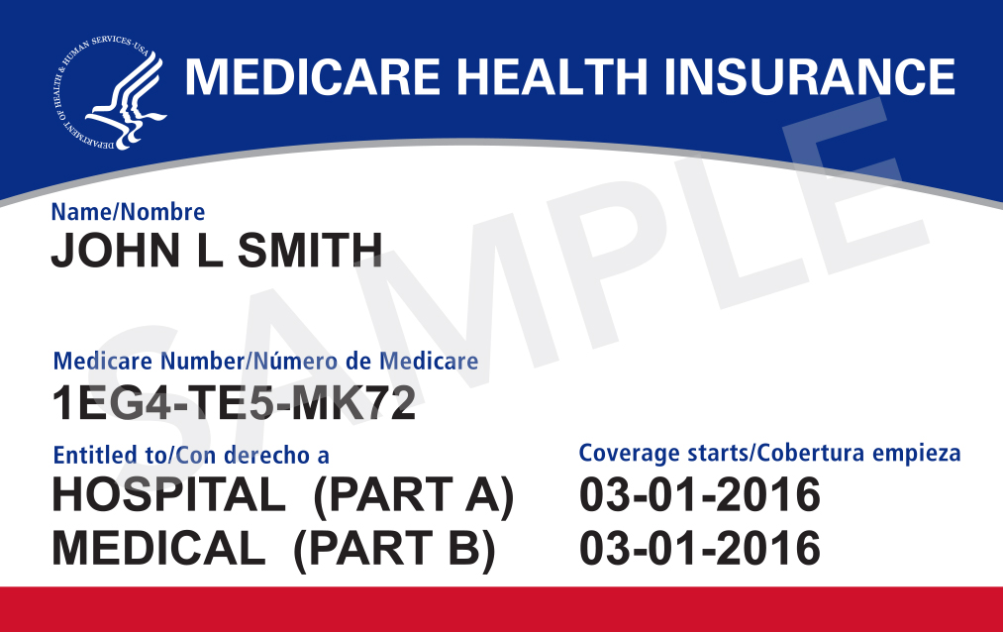
Medicare Card
Enrollment in Medicare
Notes:
This is a sample of a Medicare Card.
Your use of the Medicare Card will differ depending on the type of Medicare health plan option you choose. If you choose Original Medicare, you will use the red, white, and blue Medicare card when obtaining health care.
Your card also lists the parts of Medicare you are enrolled in and the dates they became effective.
Medicare Part A & B are the only parts that will be reflected in this card. Medicare Part C or Part D are offered through private companies. We will talk more about these options in a few minutes.

Slide 9
Medicare Basics
Notes:
Now that we have covered how to enroll in Medicare, we will review some Medicare Basics

Slide 10
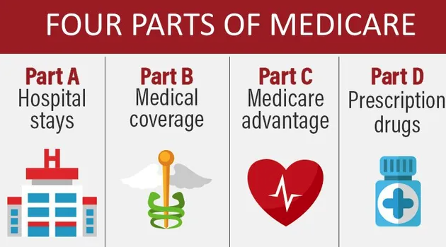
Medicare Basics
Notes:
Medicare is divided into 4 parts, and most people new to Medicare find this very confusing. Some also refer to this as the ABC & D’s of Medicare.
This chart provides a brief summary of what each part of Medicare covers.
Part A which is hospital insurance and Part B which is medical insurance are what is considered Original Medicare.
Part C also known as Medicare Advantage plans is an alternative to Original Medicare. Part C are private insurance companies who are under contract with Medicare.
Part D- is prescription drug coverage.
Both Part C & D are private companies approved by Medicare.

Slide 11

Medicare Basics
Medicare Part A
r
r
Part A
Hospital Insurance
Notes:
Let’s take a closer look at the Part A benefits.

Slide 12
Medicare Part A
Part A – Hospital Insurance
In general helps cover:
  Inpatient care in a hospital
  Skilled nursing facility care
  Nursing home care (must be inpatient care in a skilled nursing facility that’s not custodial or long-term care)
  Home health care
  Hospice care
Part A
Hospital Insurance
Notes:
Read through slide

Slide 13
Medicare Part A – 2021 Costs
Premium — No premium for most people
Deductible — $1,484 for inpatient stays (days 1-60)
Copays –
  Hospital Inpatient
  Skilled Nursing Facility
  Home health care — $0 copay.
  Hospice care — $0 copay.
Out-of-pocket maximum — None in Original Medicare.
Part A
Hospital Insurance
Notes:
These are the 2021 costs for Part A that the beneficiary is responsible for.
For most people there is no monthly premium for Part A.
The Part A Deductible for 2021 is $1484 per benefit period-which are 60 days
A benefit period begins the day you’re admitted as an inpatient in a hospital or SNF. The benefit period ends when you haven’t gotten any inpatient hospital care (or skilled care in a SNF) for 60 days in a row. If you go into a hospital or a SNF after one benefit period has ended, a new benefit period begins.
You must pay the Part A inpatient hospital deductible for each benefit period. There’s no limit to the number of benefit periods you can have.
Along with premium and deductibles- with Part A you will also have copays for most services
There is no out of pocket maximum in Original Medicare. Which is why many choose to add additional coverage options- which we will review in more detail in a few moments.

Slide 14

Medicare Basics
Medicare Part B
Part B
Medical Insurance
Notes:
Now let’s talk a look at Medicare Part B benefits..

Slide 15
Medicare Part B
Part B — Medical Insurance
Helps cover medically necessary:
Doctors’ services
Outpatient medical and surgical services and supplies
Clinical lab tests
Durable medical equipment (may need to use certain suppliers)
Diabetic testing supplies
Preventive services (like flu shots and a yearly wellness visit)
Part B
Medical Insurance
Notes:
Part B- Medical Insurance helps cover medically necessary outpatient services and supplies including:
Doctors’ services
Outpatient medical and surgical services and supplies
Clinical lab tests
Durable medical equipment
Diabetic testing supplies
Preventive services (like flu shots and a yearly wellness visit)

Slide 16
Medicare Part B – 2021 Costs
  Monthly Premium – Standard premium is $148.50 (or higher depending on your income)
  Yearly deductible – $203
  Coinsurance – 20% coinsurance for most covered services, like doctor’s services and some preventive services
    $0 for many preventive services.
Part B
Medical Insurance
Notes:
These are the 2021 Part B costs that the beneficiary is responsible for.
The Part B premium for 2021 for most is $148.50 (may be higher depending on your income)
Part B yearly deductible for 2021 is $203
Part B coinsurance is 20% for most covered services, like doctor’s services and some preventive services
You pay $0 for many preventive services.

Slide 17
Your Coverage Choices
Notes:
Next, we will discuss your Medicare Coverage choices

Slide 18
The Gaps
Medicare does not pay 100% of your medical bills.
  You may choose to purchase a Medicare Supplement (Medigap) policy if you have Original Medicare
  or
  You may choose to enroll in a Medicare Advantage Plan.
Notes:
The Gaps: Read from slide.

Slide 19
Your Coverage Choices
Original Medicare
Medicare Advantage Plan
or
Part A
Hospital Insurance
Part B
Medical Insurance
Part C
Combines Part A and Part B
May include or you may add
You can add
Part D
Prescription Drug Coverage
(Most Part C plans cover prescription drugs. You may be able to add drug coverage to some plan types if not already included.)
Medicare Supplement Insurance (Medigap) Policy
Part D
Prescription Drug Coverage
And/or
SeniorCare!
Notes:
There are 2 main ways to get your Medicare coverage—Original Medicare, or Medicare Advantage (MA) Plans. You decide which way to get your coverage.
Option 1 (on the left) : Is Original Medicare which includes Part A (Hospital Insurance) and Part B (Medical Insurance). You can choose to buy a Supplement Insurance also known as a Medigap policy to help cover some costs not covered by Original Medicare. You can also choose to buy a Medicare prescription drug plan- Part D
Option 2 (on the right): Is Medicare Advantage Plans also known as Medicare Part C or MA plans. Medicare Advantage Plans are another way to get your Medicare Part A and Part B coverage. Medicare Advantage Plans are offered by Medicare-approved private companies that must follow rules set by Medicare. Many plans include prescription drug coverage but you can choose a plan without drug coverage and add WI SeniorCare coverage. We will talk more about SeniorCare in a few moments.
You cannot have a Medigap policy and a Medicare Advantage plan at the same time. Medicare Beneficiaries need to choose one path- either the one on the right OR the one on the left for coverage.

Slide 20


Original Medicare
Original Medicare is Part A (Hospital Insurance) and/or Part B (Medical Insurance).
Medicare provides coverage.
You have your choice of doctors, hospitals, and other providers that accept Medicare
Part A
Hospital Insurance
Part B
Medical Insurance
You can add
Medicare Supplement (Medigap) Insurance
Part D
Notes:
Here are a few more details about the path on the left- Which is choosing to stay with Original Medicare (so using your Red/White and Blue card) which includes the Part A (Hospital Insurance) and/or Part B (Medical Insurance).
With this path, Medicare provides your coverage.
You have your choice of any doctors, hospitals and other providers that accept Medicare
You can choose to buy a Medicare Supplement insurance (also know as Medigap) policy to help cover some costs not covered by Original Medicare.
You can also choose to add a Medicare prescription drug plan (Part D)

Slide 21
Original Medicare
Medicare Supplement Policies
(Medigap)
Notes:
Let’s take a closer look at Medicare supplement policies

Slide 22
Medicare Supplement (Medigap) Insurance
Private Insurance to supplement Original Medicare.
All policies are Approved & regulated by WI Commissioner of Insurance.
    Helps pay some health care costs that Original Medicare doesn’t cover.
    Once Medicare pays its share of Medicare-approved amounts for covered costs, then your Medigap policy pays its share.
You pay a monthly premium for this type of plan. ($125 to $350+ month)
      Costs vary depending on insurance company, optional benefits selected, age of applicant, where applicant lives.
      No need to review coverage yearly.
Notes:
A Medicare Supplement Insurance policy is private health insurance that’s designed to supplement Original Medicare. It helps pay some of the health care costs that Original Medicare doesn’t cover (like copayments, coinsurance, and deductibles). Medicare will pay its share of the Medicare-approved amounts for covered health care costs, usually around 80%. Then your Medigap policy pays the remaining 20% of costs.
You will pay a monthly premium for the supplement policy. Premiums will vary depending on the insurance company, the benefits selected, the age of the applicant and where the applicant lives. Policy premiums also tend to increase a bit each year.
Medigap policies cover only one person. If you and your spouse both want coverage, you’ll need to have separate Medigap policies.
You will still pay the monthly Part B premium
There is no need to review coverage yearly- people keep same supplement for many years.

Slide 23
Medigap Insurance
Types of Policies
  Traditional Medicare Supplement Policies
    Attained Age – As you age your premiums will change to meet your age range and premiums become higher.*
    Issue Age – Premiums are set at the age you are when you buy the policy and will not increase because you get older.* Premiums may increase for other reasons.
  Cost-Sharing Supplemental Policies (50% or 25% cost sharing)
  High-Deductible Medicare Supplement
  Medicare Select
Notes:
There are different types of Medigap Policies. This slide reviews the type of policies that are available. To purchase a Medicare supplement policy, you must meet with a licensed insurance agent who can further review all your options.

Slide 24
Medigap Insurance
Basic Benefits:
20% approved amount after Medicare on most services
Wisconsin Mandated Benefits:: Wisconsin insurance law requires that supplement polices contain certain mandated benefits. These benefits are available even when Medicare does not cover the expenses.
Only applies to policies issued in Wisconsin to Wisconsin residents
Notes:
For most Medigap policies the Basic Benefits covers the 20% approved amount after Medicare pays it’s 80% on most services
Wisconsin also has several Mandated Benefits.
Wisconsin insurance law requires that supplement polices contain certain mandated benefits. These benefits are available even when Medicare does not cover the expenses.
Please note that this Only applies to policies issued in Wisconsin to Wisconsin residents

Slide 25
Medigap Insurance
Optional Riders (Benefits):
Part A Deductible (or Part A 50% Deductible)
Part B Deductible*
Part B Copay/Coinsurance (reduces premiums)
Part B Excess Charges
Additional Home Health (up to 365 visits per year)
Emergency Foreign Travel
*As of January 1, 2020 the Part B Deductible rider is no longer an option for people newly eligible for Medicare. (Still available for those eligible prior to 1/1/20.)
Notes:
In addition to the basic benefits, all Medigap insurance offers optional benefits also known as “riders”. Each of the optional riders must be priced and sold separately from the basic policy
Some of these optional choices are listed here. For more detailed information on riders, ask your insurance agent or contact the ADRC!

Slide 26

Medigap Insurance
Office of the Commissioner of Insurance of Wisconsin (OCI)
2021 Medicare Supplement Insurance Policies List (companies selling Medicare supplement policies in Wisconsin)
Guide to Health Insurance for People with Medicare in Wisconsin
www.oci.wi.gov or 1-800-236-8517
Notes:
Another great resource for information on policies can be found with Office of the Commissioner of Insurance in Wisconsin. OCI is the agency responsible for the regulating and licensing of insurance and has many great resources available.
You can find these resources online at the website listed, by calling OCI directly or by contacting the ADRC!

Slide 27
Medigap Insurance
When You Can Buy a Medigap Policy
Your one-time 6-month Open Enrollment Period (OEP) begins when you’re 65 or older and enrolled in Part B.
May buy a Medigap policy any time an insurance company will sell you one.
During Your Medigap OEP | NOT During Your Medigap OEP
Best time to buy | May have waiting period for preexisting conditions
Guaranteed Issue Period | May cost more
Companies must sell to you any policy they sell for the same price even if you have a pre-existing condition | Companies can deny coverage
Notes:
The best time to buy a Medigap policy is during your Medigap Open Enrollment Period. This period lasts for 6 months and begins on the first day of the month in which you’re both 65 years of age or older and enrolled in Medicare Part B. If you apply during this timeframe, you can buy any Medigap policy the company sells, even if you have health problems, for the same price as people with good health. If you don’t purchase a plan within your 6-month Open Enrollment Period, insurance companies can deny coverage based on your health condition.
Outside of an OEP- You may buy a Medigap policy any time that an insurance company will sell you one.

Slide 28
Medigap Insurance
Steps to Buy a Policy
STEP 1: Decide which benefits (riders) you want, then decide which of the Medigap policies meets your needs.
STEP 2: Find out which insurance companies sell Medigap policies in your state.
STEP 3: Call the insurance companies (or insurance agent) that sell the Medigap policies you’re interested in and compare costs.
STEP 4: Buy the Medigap policy.
Notes:
Listed here are the steps to take if you are interested in buying a Medigap policy

Slide 29
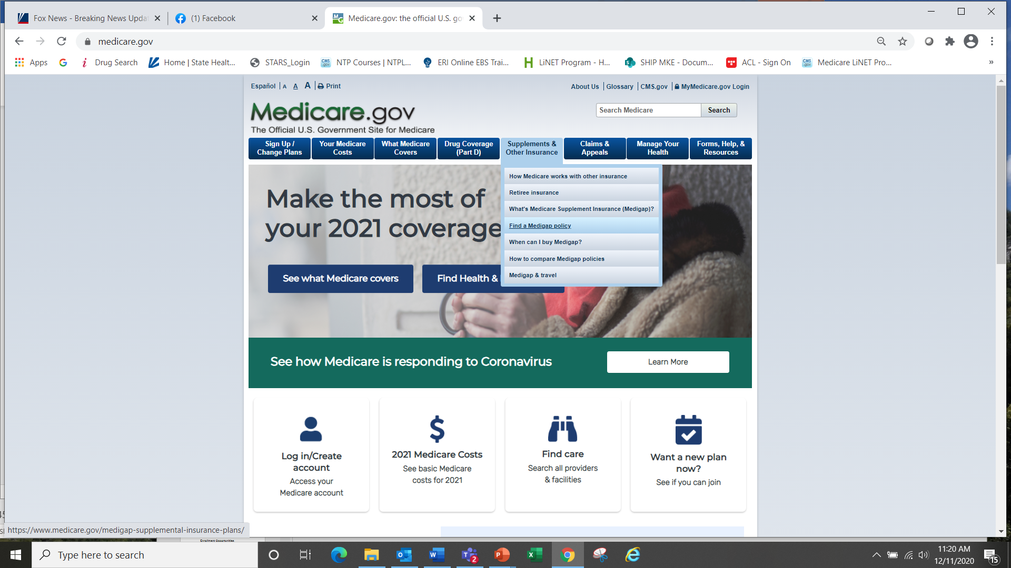
Medigap Insurance
For Questions Contact:
WI SHIP Medigap Helpline
1-800-242-1060
Commissioner of Insurance
1-800-236-8517
https://oci.wi.gov
Medicare
1-800-MEDICARE
www.Medicare.gov
ADRC of Buffalo & Pepin Co
1-866-578-2372
www.adrc-bcp.com
Notes:
Here are some additional resources that can help answer any questions you may have about Medigap policies.

Slide 30

Medicare Part D
Part D
Medicare prescription drug coverage
Medicare Prescription Drug Coverage
Notes:
Next, let’s take a closer look at Medicare Part D- which is Prescription Drug Coverage

Slide 31
Medicare Part D
To receive Part D coverage, you must enroll in a Part D Plan.
Covers prescription medications.
Run by private companies that contract with Medicare.
Part D Plans are provided through:
  Medicare Prescription Drug Plans (PDPs) that work with Original Medicare.
  Medicare Advantage Prescription Drug Plans (MA-PDs).
Part D
Medicare prescription drug coverage
You can compare plans and enroll in a plan on the Plan Finder at: www.medicare.gov
Notes:
To receive Part D coverage, you must enroll in a Part D Plan
Plans cover prescription medications only
These plans are run by private companies that contract with Medicare.
If you chose Original Medicare and you want prescription drug coverage, you must choose and join a stand-alone Medicare Prescription Drug Plan. You usually pay a monthly premium. In Wisconsin for 2021- there are 31 stand-alone prescription drug plans available to choose from.
Part D coverage is also provided through Medicare Advantage (Part C) Plans.

Slide 32
Medicare Part D – Costs
  Premiums, Deductibles, and Copays or Coinsurance
    Costs vary by plan and change annually.
    2021 plan premiums range from $7.30 to $132.30 per month.
    2021 deductible is $445.
    Copays and coinsurance may vary per drug, per plan, per pharmacy.
  Note: Income Related Monthly Adjustment Amount (IRMAA)
    People with Part D who have higher incomes will pay an additional amount on top of their premium.
Part D
Medicare prescription drug coverage
Notes:
Here are the 2021 costs related to Part D.
Costs vary by plan and change annually.
2021 plan premiums range from $7.30 to $132.30 per month.
2021 deductible is $445.
Copays and coinsurance may vary per drug, per plan, per pharmacy.
Please note that people with Part D who have higher incomes will pay an additional amount on top of their plan premium.

Slide 33
Medicare Part D – Costs
  Late Enrollment Penalty
    You may pay a late enrollment penalty if you did not enroll in Part D during the IEP and did not have other creditable coverage*.
    The penalty is 1% of the average national monthly premium for every month you delayed enrollment.
    The penalty will be added to your monthly premium if and when you enroll in a Part D plan, and it will continue as long as you are enrolled
  *Creditable Coverage: Other prescription drug coverage that is expected to pay, on average, at least as much as Medicare’s standard Part D coverage, such as:
      Veterans drug coverage
      SeniorCare
      Some types of Employer Coverage
Part D
Medicare prescription drug coverage
Notes:
Part D Late Enrollment Penalty
You may pay a late enrollment penalty if you did not enroll in a Part D plan during your IEP and did not have other creditable coverage*.
The penalty is 1% of the average national monthly premium for every month you delayed enrollment.
The penalty will be added to your monthly premium if and when you enroll in a Part D plan, and it will continue as long as you are enrolled
*Creditable Coverage is defined by Medicare as: Other prescription drug coverage that is expected to pay, on average, at least as much as Medicare’s standard Part D coverage.
Some options that count as creditable coverage include:
Veterans drug coverage
Senior Care
& some types of Employer Coverage

Slide 34
Medicare Part D – Costs
TOTAL drug costs =
$4,130
Total OOP costs =
$6,550
Deductible =
$445 or less
Part D
Medicare prescription drug coverage
Catastrophic Period
D
Initial Coverage
Period
Coverage Gap
Beneficiary pays either 25% or actuarially equivalent tier structure.
Beneficiary pays 25% of brand name drugs and 25% of generic drugs.
Beneficiary pays 5% or $3.70 for generics and $9.20 for brand-names.
From January 1, 2021 (or a later start date for those who enroll after January 1).
Notes:
This graph sums up the Medicare Part D costs for 2021, which you can review in your handout.

Slide 35
Medicare Part D
What is Covered
Prescribed medications
Medications that are included in a plan’s formulary- which is the plan’s list of covered drugs
**Not all medications are covered by all plans**
Medications must be for medically prescribed use.
Part D
Medicare prescription drug coverage
Notes:
Medicare Part D plans cover:
Prescribed medications.
Medications that are included in a plan’s formulary- which is the plan’s list of covered drugs. Not all medications are covered by all plans.
Medications must be for medically prescribed use.

Slide 36

Medicare Part D
What Is Not Covered?
Medications that are not on a plan’s formulary are usually not covered.
Non-prescription, over-the-counter drugs
Drugs that are not approved by the Federal Drug Administration (FDA)
Vitamins and minerals
Cough medicine
Drugs for cosmetic purposes
  Weight loss or weight gain
  Hair loss
Notes:
It is important to be aware that these items are not covered by Medicare Part D.
Medications that are not on a plan’s formulary
Non-prescription, over-the-counter drugs
Drugs that are not approved by the Federal Drug Administration (FDA)
Vitamins and minerals
Cough medicine
Drugs for cosmetic purposes
Weight loss or weight gain
Hair loss
Also, please note that “off-label” use of prescription medications is not covered by Part D. For example, if a doctor prescribes a medication for a condition, but the FDA does not approve the use of that medication for that condition—then the drug will not be covered—even if it is in the plan’s formulary for use with other conditions!

Slide 37
Your Coverage Choices
Original Medicare
Medicare Advantage Plan
or
Part A
Hospital Insurance
Part B
Medical Insurance
Part C
Combines Part A and Part B
May include or you may add
You can add
Part D
Prescription Drug Coverage
(Most Part C plans cover prescription drugs. You may be able to add drug coverage to some plan types if not already included.)
Medicare Supplement Insurance (Medigap) Policy
Part D
Prescription Drug Coverage
Notes:
Now lets take a look at the other way of receiving your Medicare coverage: Medicare Advantage Plans, also known as Medicare Part C.

Slide 38



Medicare Advantage Plans (Part C)
Part C Includes
Medicare Advantage, sometimes called Part C, includes both Part A, Part B, and usually Part D.
Private insurance companies approved by Medicare provide your Medicare coverage.
Most common plans are:
Health Maintenance Organization (HMO)
Preferred Provider Organization (PPO)
Private Fee-for-Service (PFFS)
Special Needs (SNPs)
You must use plan doctors, hospitals, and other providers, or you will pay more or all of the costs.
Part A
Hospital Insurance
Part B
Medical Insurance
Most include Part D
Medicare prescription drug coverage
Notes:
Medicare Advantage plans includes both Part A & Part B, and usually Part D.
They are Private insurance companies approved by Medicare provide your Medicare coverage.
The most common plans are:
Health Maintenance Organization (HMO)
Preferred Provider Organization (PPO)
Private Fee-for-Service (PFFS)
Special Needs Plans (SNPs)
You must use plan doctors, hospitals, and other providers, or you will pay more or all of the costs
You must use the card from your Medicare Advantage Plan to get your Medicare-covered services. You should keep your red, white, and blue Medicare card in a safe place because you’ll need it if you ever switch back to Original Medicare.

Slide 39
Medicare Advantage Plans
Part C Includes
What you Pay in 2021
Part A
Hospital Insurance
Part B
Medical Insurance
Part B monthly premium
Additional monthly premium depending on the plan ($0-$226) for 2021 plans in Buffalo & Pepin Co
Deductibles, coinsurance, and copayments
  Different from Original Medicare
    Vary from plan to plan
    May be higher if out-of-network
Out-of-Pocket Maximum – $6,700 (individual)
Most include Part D
Medicare prescription drug coverage
Notes:
If you join a Medicare Advantage Plan, you must continue to pay the standard monthly Medicare Part B premium. As a reminder, the Part B premium in 2021 is $148.50.
When you join a Medicare Advantage Plan there are other costs you may have to pay, such as
Additional monthly premium to the plan- this can range from $0- up to $226/ month for plans in Buffalo or Pepin Co for 2021
You may pay deductibles, coinsurance, and copayments
These costs may
Be different from Original Medicare
Vary from plan to plan
Be higher if you go out of network
The out-of-pocket maximum for 2021 is $6,700 for an individual This is a yearly limit on your out-of-pocket costs for medical services. If you reach this limit, you’ll pay nothing for covered services for remainder of the calendar year. This limit may be different between Advantage Plans and can change each year. You should consider this when choosing a plan.

Slide 40
Medicare Advantage Plans
Part C Includes
If you join a Medicare Advantage Plan you:
  Still get all services covered by Part A and Part B, but you get them through the Medicare Advantage Plan.
  May choose a plan that includes Part D prescription drug coverage.
  Can’t be charged more for certain services than you would pay under Original Medicare.
  May choose a plan that includes extra benefits not covered by Original Medicare, such as vision, hearing or dental care.
Part A
Hospital Insurance
Part B
Medical Insurance
Most include Part D
Medicare prescription drug coverage
Notes:
If you join a Medicare Advantage Plan, you
Still get all services covered by Part A and Part B, but you get them through the Medicare Advantage Plan
May choose a plan that includes prescription drug coverage or one without
You can’t be charged more for certain services that you would pay under Original Medicare
May choose a plan that includes extra benefits not covered by Original Medicare, such as vision, hearing or dental care.

Slide 41
Medicare Parts C & D
Annual Open Enrollment Period
October 15th – December 7th
Medicare Advantage Plans (Part C) and Medicare Prescription Drug Plans (Part D) can change their plan details each year.
Plan formularies, pharmacy networks, premiums, and other costs can change each year.
Review your current plan each year!
Notes:
It’s important to mention that Medicare Advantage Plans and Medicare Prescription Drug Plans can change their plan details each year.
Plan formularies, pharmacy networks, premiums, and other costs can change each year.
It is important to review your plan each year, and note any changes to the plan.
Medicare’s Annual Open Enrollment Period runs from Oct 15th – December 7th each year. This is an opportunity to compare plans to be sure you will be in a plan that covers you well in the new year.

Slide 42
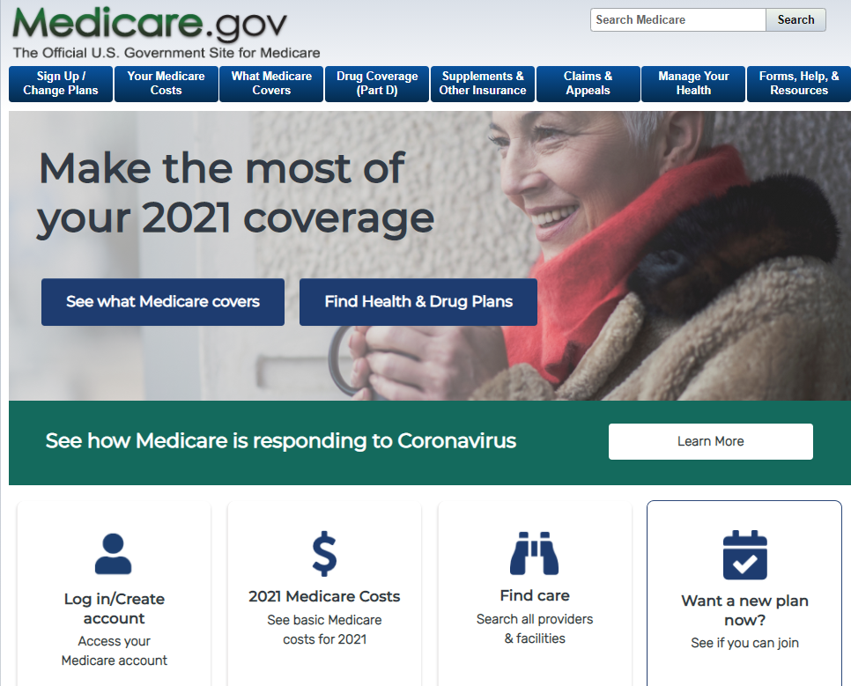
The Medicare Plan Finder
Compare plans at www.medicare.gov
Click “Find Health & Drug Plans?”
Personalize your search to find plans that meet your needs.
Compare plans based on star ratings, formularies, benefits, costs, and more.
Notes:
You can compare plans by using the Plan Finder tool on the Medicare website. You can enroll in plans online at medicare.gov, by calling Medicare directly or by contacting the plan directly. The ADRC also helps beneficiaries with this process!

Slide 43

SeniorCare
Wisconsin’s Prescription Drug Assistance Program
Available to Wisconsin residents age 65 and over who are U.S. citizens or have qualifying immigrant status.
$30 annual application fee. (No monthly premium.)
No asset limit.
Creditable coverage.
Your annual income determines your level of coverage.
  No deductible at Level 1.
  Level 2a and 2b have a deductible.
  Level 3 has a deductible and spenddown.
May use alone or in addition to Part D.
For more information or to access an application online: www.dhs.Wisconsin.gov/seniorcare
Or call:
1-800-657-2038
Notes:
Another option for creditable prescription drug coverage you may want to consider is Wisconsin’s prescription drug assistance program, called SeniorCare.
Senior Care is Available to Wisconsin residents age 65 and over who are U.S. citizens or have qualifying immigrant status.
It is low cost- $30 annual application fee. (No monthly premium.)
There is no asset limit to qualify
SeniorCare is considered creditable coverage for Medicare
Your annual income determines your level of coverage.
May use SC alone or in addition to Part D.
For additional information, you can find SeniorCare online or by calling the phone number on this slide. The ADRC is also available to help with any questions and provides application assistance ☺

Slide 44
Other Types of Health Insurance
Employer/Retiree Group Health Plan
  Some offer creditable prescription coverage.
  Contact your employer or union benefits administrator to find out how your insurance works with Medicare.
Military Coverage: VA or TriCare
Medical Assistance/Low Income Programs
Notes:
Here are some other ways that people may receive coverage for their healthcare when age 65 or older.
You may have the option of an Employer or a Retiree Group Health Plan
Some of these plans may offer creditable prescription coverage. You should contact your employer or union benefits administrator to find out how your insurance works with Medicare.
You may qualify for Military Coverage: thru the VA or TriCare
Or you may be eligible for Medical Assistance (also known as Medicaid) and other Low- Income Assistance Programs.

Slide 45

Help for People with Limited Income
Medicare Savings Programs
  If eligible, your Medicare Part B premium will be paid for you.
  Some also have Medicare copays and deductibles paid (eligibility based on income and assets)
Extra Help (Low Income Subsidy)
  Assistance with Medicare prescription drug coverage.
  Reduces Part D premiums, deductibles, and copays (eligibility based on income and assets)
Senior Care
  Level of assistance depends on annual income.
  Level 1 has no deductible and pay $5 generic/$15 brand name prescription
Notes:
Medicare also has several programs available to Help People with Limited Income
Many people with Medicare face challenges when it comes to paying for health care and prescription medications. In fact we often hear of people who have to choose between paying for groceries or paying for healthcare or medicine. Here are some programs that can help:
Medicare Savings Plans
If eligible, your Medicare Part B premium will be paid for you.
Some also have Medicare copays and deductibles paid (eligibility is based on income & assets)
Extra Help (Low Income Subsidy) Program thru Social Security
Program offers assistance with Medicare prescription drug coverage.
If eligible, reduces Part D premiums, deductibles and copays
Senior Care
As discussed previously, your level of assistance depends on annual income.
Level 1 SeniorCare has no deductible and you pay $5 for each generic prescription and $15 for each name brand prescription

Slide 46
Help for People with Limited Income
Program Eligibility Guidelines
Program | Single Individual (Unmarried) |  | Married Couple
 | Monthly Income | Assets | Monthly Income | Assets
Medicare Savings Program | < $1,449 | < $7,970 | < $1,959 | < $11,960
Extra Help | < $1,610 | < $13,290 | < $2,177 | < $26,520
Wisconsin SeniorCare Level 1 | < $1,717 | No asset limit | < $2,322 | No asset limit
*Income Limits based on 2021 federal poverty guidelines.
Notes:
This chart shows the eligibility guidelines for theses benefit programs. Even if a person doesn’t meet these limits, I encourage you to fill out an application or contact us for assistance if you are struggling with paying for healthcare or prescription costs.
Please note that these income limits change yearly and people may be eligible for other savings programs depending on their situation.

Slide 47
Words of Caution
Steps to Prevent Fraud
Step 1: Protect Yourself and Others from Medicare Fraud
DON’T
DO
Do treat your Medicare card and number like your credit card.
Do watch out for identity theft.
Do be aware that Medicare doesn’t call or visit to sell you anything.
Do be cautious of offers for “free” medical services.
Don't give out your Medicare number except to your doctor or other Medicare provider.
Notes:
Lastly, I’d like to review a few words of caution on Steps to Prevent Medicare Fraud
Don't give out your Medicare number except to your doctor or other Medicare provider.
Do treat your Medicare card and number like your credit card.
Watch out for identity theft.
Be aware that Medicare doesn’t call or visit to sell you anything.
Be cautious of offers for “free” medical services.

Slide 48

Words of Caution
Report Suspected Medicare Fraud and Abuse
Call the provider to discuss any concerns you have about a bill
Contact WI Senior Medicare Patrol (SMP)
SMP help Medicare beneficiaries prevent, detect and report health care fraud, errors and abuse
  Call Toll-free: 1-888-818-2611 (Free and Confidential!)
Notes:
Please report any suspected Medicare fraud & abuse
Call the provider to discuss any concerns you have about a bill
If further follow up is needed- in Wisconsin we have an agency called Senior Medicare Patrol also known as (SMP) that can help Medicare beneficiaries prevent, detect and report health care fraud, errors and abuse . The SMP toll free number is listed here and their services are free and confidential!

Slide 49

Notes:
Before we end, let’s check back in with Peter, from the start of the presentation. Peter is giving me a thumbs up which I am going to assume means that I didn’t give him too much of a headache and helped to clarify some of his questions with Medicare. Yay! That’s great Peter!!

Slide 50
For More Information or Assistance
Call Medicare at 1-800-633-4227 or visit www.medicare.gov
Wisconsin Resources:
  Medigap Helpline: 1-800-242-1060
  Medigap Part D Helpline (for ages 60+): 1-855-677-2783
  Disability Drug Benefit Helpline: 1-800-926-4862
Local Assistance:
  ADRC of Buffalo & Pepin Counties: 1-866-578-2372
Notes:
However, If you are not feeling as sure as Peter, you are not alone and here are some local agencies that can help if you have questions or need additional information or assistance with Medicare

Slide 51
For More Information or Assistance
  Contact:
  ADRC of Buffalo & Pepin Counties: 1-866-578-2372
  Visit our website at: https://www.adrc-bcp.com/
  Find us on facebook
  https://www.facebook.com/ADRCBuffaloAndPepinCounties/
Notes:
Lastly, listed here are some resources that the ADRC has available.
Thank you for your time and for attending the Welcome to Medicare program today.

