Slide 1


Hospice 101
Notes:
Hello – Welcome to Hospice 101
Let’s get started.

Slide 2

St. Croix Hospice Values
Integrity
Collaboration
Accountability
Respect
Excellence
Notes:
Our mission at St. Croix Hospice is to deliver the highest quality hospice care.
Our values, or the way we work to achieve our mission include I CARE.
We will work together with integrity and collaboration efforts. We’ll hold ourselves and each other accountable for our actions, treat one another with respect while we strive for excellence in providing hospice care.

Slide 3
Objectives
History of Hospice
Benefits of Hospice
Where Hospice is Provided
The Hospice Care Team
Hospice Eligibility
Hospice Myths
Notes:
Objectives of today’s learning opportunity – little hx of hospice, cover the benefits of hospice and where care takes place.
Also talk about the Care Team – who they are and responsibilities, what makes a person eligible for hospice care, and lastly, but importantly
discuss some prevailing or popular hospice myths, providing the correct information pertaining to hospice care.

Slide 4
“You matter because of who you are, and you matter to the last moment of your life. We will do all we can, not only to help you die peacefully, but also to live until you die.”
-Dame Cicely Saunders
Founder of the Hospice Movement
Notes:
Dame Cicely Saunders- Contemporary Hospice Movement
Trained as a nurse, medical social worker and finally as a physician
Founded St Christopher's Hospice, London in 1967.
Revolutionized the way society cares for the ill, dying and bereaved

Slide 5
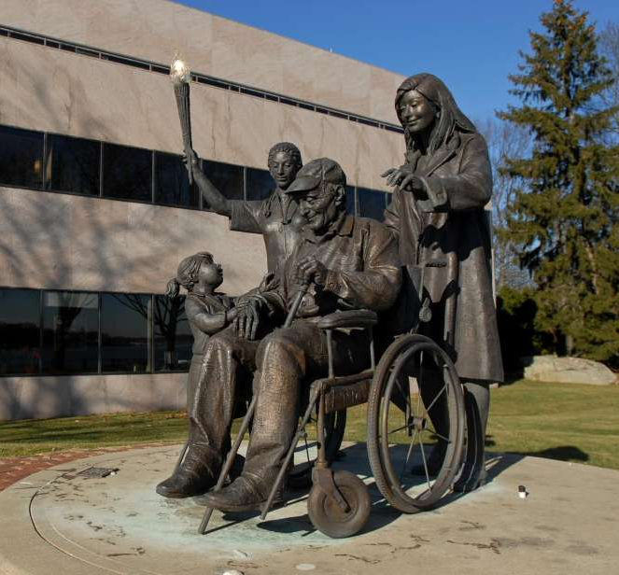
History of Hospice
1974: America’s first hospice, The Connecticut Hospice, began providing hospice care in the home, funded by the National Cancer Institute.
1993: Hospice is introduced as a nationally guaranteed benefit under President Clinton’s health care reform proposal. Hospice is now an accepted part of the health care continuum.
Notes:
Hospice, Inc.-Connecticut: First Hospice in the U.S. 1974
The Hospice Medicare Benefit: Enacted in 1982, but it took until 1993 for hospice to become more of a mainstream health care choice. That’s because hospice was introduced as a nationally. . . .
National Hospice and Palliative Care Organization- 2020 edition reported:
In 2018, more than 1.55M patients received hospice care in the U.S.
In 2018, there were more than 4600 hospice providers in the U.S., most are freestanding independent entities, a much smaller portion are part of a hospital system or home health agency.

Slide 6
History of Hospice
Early mandates of hospice
Hospice recognizes dying as part of the normal process of living
Hospice focuses on maintaining quality at the end of life
Hospice neither hastens nor postpones death
Through appropriate care, patients and their families may be free to attain a degree of mental and spiritual preparation for death
Notes:
Today hospice care is considered the model for quality compassionate care for people facing a life-limiting illness. It provides expert medical care, pain and symptom management and emotional and spiritual support tailored to meet a patient’s wishes and needs. Hospice care is focused on comfort care while maintaining quality of life.

Slide 7
Medicare Hospice Benefit
To be eligible to elect hospice care under Medicare, an individual must be entitled to Part A of Medicare and be certified as being terminally ill.
An individual is considered terminally ill if the medical prognosis of life expectancy is six months or less if the illness runs its normal course.
Hospice admits a patient only on the recommendation of the medical director with input from the patient’s attending physician.
Notes:
Hospice care is covered by Medicare, Medicaid, VA benefits and most private insurers.
It is a fully funded Medicare/Medicaid benefit, which covers all services related to the terminal illness. There are no co-pays or out-of-pocket costs.
For patients with private insurance, there may be some deductible and out of pocket costs that need to be met.
Hospice care is meant for anyone with a life-limiting illness (terminal illness), that if left to run its normal course, the person’s prognosis is 6 months or less. However, this does not mean there is a 6-month limit to hospice care services.
After the initial certification period (2-90 day periods), each beneficiary receives an unlimited number of additional 60-day periods. People can live for years on the hospice benefit as long as their physician or hospice medical director still believes that they have a life expectancy of six months or less.

Slide 8
Benefits of Hospice
Physical Care Management
Psychosocial Care Management
Spiritual Care Management
Alternative Therapies
Volunteer Support
Grief & Bereavement
Notes:
Physical Care Management – overseen by hospice Medical Directors and nursing team.
Experts in pain and symptom management that is associated with EOL
Hospice provides all medications, supplies and medical equipment related to terminal illness
Registered nurse and hospice aide visits are scheduled during the week; not only to provide cares but also to educate the patient, family and caregivers about the care plan.
In addition RNs are on call 24/7/365 to answer questions or provide urgent care when needed.
Dietician may also help with a patient’s end-of-life nutrition needs to provide education to caregivers about nutritional changes in someone reaching EOL
Psychosocial Care Management – responsibility of the Social Worker
Some of the responsibilities include: conducting psychosocial assessments, assisting in EOL planning completion, and educating patients and families on the available resources and support systems.
psychosocial assessments of patients and their families is important to determine their psychological, emotional, spiritual, and social needs. This information is vital to the care team so they may develop an effective and compassionate care plan.
Spiritual Care Management – managed by hospice chaplain
Hospice chaplain’s main responsibility is to provide non-denominational emotional and spiritual support to patients, their families and caregivers. They are trained to support a patient’s medical care from a spiritual and emotional perspective.
They may act as liaisons between members of the community clergy and hospice patients.
Additionally, chaplains provide bereavement services, including phone calls, visits, and memorial services, to family members upon the death of a patient.
Alternative Therapies - preCOVID
Music therapy – provide peace, relaxation and joy
Massage therapy – provide relaxation, pain relief and compassionate touch
Volunteer Services - preCOVID
Medicare requires volunteer hours to equal at least 5% of a hospice providers total patient care hours
Companionship, EOL Vigils, Pet Therapy (at SCH we believe no one should die alone, dedicated volunteers to assist with vigils)
Grief and Bereavement Support
Anticipatory grief counseling can be provided by the Social Worker and/or Chaplain while patient is still living
After the patient’s death, our team can help navigate available community resources needed during time of grief
SCH provides bereavement services 13 months after the patient passes – 13 months includes A LOT of “firsts” and anniversaries without a loved one. People grieve differently and at different rates. We don’t want anyone to be without the support they need during this time.

Slide 9
Benefits of Hospice
Making the most of life
Hospice is often equated with end-of-life medical care. But hospice benefits reach far beyond a patient’s physical condition to cover the spiritual and psychosocial needs of the patient as well as the family.
Medical care
Hospice’s expertise in care assures the patient state-of-the-art symptom management and pain control, improving quality of life
A hospice nurse and hospice aide are assigned to each patient to manage medical needs
The freedom to choose
One of the great fears of terminally ill patients is losing control over what happens to them. Hospice supports the individual wishes of each patient and family.
Notes:
Medical Care – The hospice team’s expertise in care assures a high level of awareness and care for symptom management and pain control. Ultimately improving quality of life.
A hospice nurse and aide are assigned to every patient to manage medical needs.
The freedom to choose – one of the most important keys to what hospice care is about.
One of the great fears. . .
It is vitally important to the success of hospice care that patients make their choices known and these choices are respected right til the end of life.

Slide 10
Benefits of Hospice
Preventing hospitalizations/rehospitalization
Studies have shown hospice care can dramatically reduce hospitalizations. This is possible because of a well constructed plan of care, including an interdisciplinary team approach delivered directly wherever the patient calls home.
24/7 Availability
Expert hospice team offer patients and families access to professionals 24 hours a day, seven days a week, including nights, weekends and holidays.
Continued communication & education
Much anxiety surrounding end-of-life care comes from simply not having answers. At St. Croix Hospice, there is always a ready resource with reliable information, guidance and reassurance for the patient, family and facility staff.
Notes:
The interdisciplinary team – the hospice medical directors, nurses, SWs and chaplains. SCH patients have a less than 1% rehospitalization rate
Continued communication and education – add on
Part of the nurse manager’s role is to make certain caregivers – whether at home or in facility – understand how best to care for the patient and what to expect at EOL. Due in part to COVID, we are providing care for more patients in their own home/family’s home now. Our team understands family members are not often trained caregivers. Our team will provide the necessary education and instruction to best care for the patient and do so safely for all.

Slide 11
Benefits of Hospice
Patient Centered Care
Palliative (comfort) vs. curative care
Symptom management
Changing needs of patients and families
Respect for patients
Autonomy
Security
Notes:
Summary of the key points of Hospice Care
Comfort vs. Curative: with a focus on comfort care, allowing patient to accomplish goals in the time remaining and die a natural death wherever they call home, surrounded by friends and loved ones.
Symptom Management: Continuous pain assessment and pain control is a core principle and practice in hospice care. We do this while balancing the patient’s quality life which is equally important.
Changing Needs: As the illness progresses, physical, psychosocial and spiritual needs change for both patient and family. Hospice will meet these changing needs by altering the plan of care. The plan of care is intended to be fluid, adapting to the needs of the patient.
Respect for Patients: By focusing on patients needs and treating each individual and family as special and unique, the hospice team fosters the patient’s sense of respect and control over their care
Autonomy: Hospice promotes patient autonomy. An appropriate hospice death is one in which dying is in accordance with the patient and family’s wishes and in congruence with their life
Security: Hospice orchestrates a community of caregivers, including staff, volunteers, family, friends and community resources, so the patient and family feel the security of not traveling on this journey alone

Slide 12
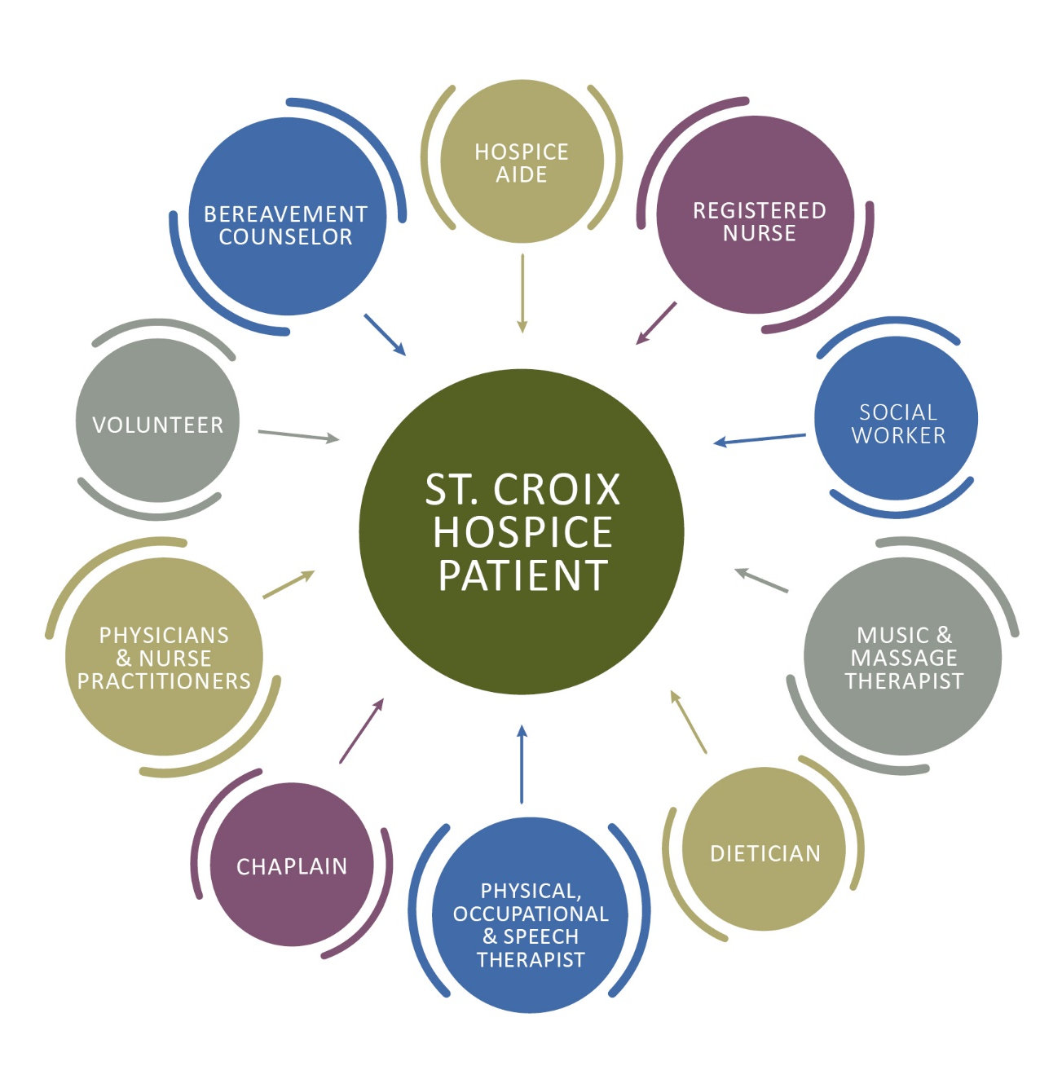
Benefits of Hospice
A Coordinated Interdisciplinary Team Approach
This interdisciplinary approach is widely considered to be one of the most important benefits of hospice care.

Slide 13
Benefits of Hospice
Facility Centered Care
Facility staff are an important part of the team of primary caregivers
Communication is key and hospice heavily involves the facility
Hospice teams follow facility regulations and protocols
Hospice care complements the care provided by facility staff
Hospice promotes collaboration and customization that supports patients, families and facilities
Notes:
We rely on the facility team to be our “eyes” on the patient when we are not providing cares. Someone on hospice can change/decline rapidly, we need the facility team to understand what is going on and reach out when we are needed at anytime, especially afterhours, on weekends.
ALL hospice care is over and above the care provided by the facility care teams. It is truly EXTRA care.

Slide 14
Benefits of Hospice
Research Indicates:
Studies show patients who chose hospice care live an average of 29 days longer than those who do not have hospice care
Family members report greater satisfaction in care of their loved one and support with hospice care
Facility and community staff have been shown to be able to provide higher quality care when residents and families choose hospice care
Notes:
Research Showed:
Why lived longer? May be several reasons - Fewer hospitalizations, doctors visits and invasive treatments, may be simply not as taxing on the patient.
36% of patients reported pain that affected sleep at first hospice care visit, by next visit it was reduced to 8%. We know that continued pain as well as not getting adequate sleep both have a negative effect on a person’s health – draining energy and interfering with healing abilities.
For those of you interested in more information on this first bullet point – it was published in March 2007 in the peer-reviewed publication of the Journal of Pain and Symptom Management.

Slide 15
Benefits of Hospice
Hospice support includes:
An interdisciplinary team
Durable medical equipment (DME) related to terminal diagnosis
Hospice medications/supplies related to terminal diagnosis
Notes:
Hospice provides numerous resources related to the terminal diagnosis including:
Durable Medical Equipment (DME) which may include
Beds: specialty mattresses, side rails (if allowed)
Wheelchairs/walkers, different types of lifts to assist with patient care
Oxygen and supplies
Bedside Commodes
Medications – relating to terminal diagnosis and those needed to provide comfort and pain control
Supplies including incontinence products and wound care supplies
Incontinence products, including wipes
Catheters, etc
Wound care supplies

Slide 16
Levels of Hospice Care
Level 1: Routine Care
Level 2: Continuous Care
Level 3: General Inpatient Care
Level 4: Respite Care
Determining Level of Care
Qualifying for hospice, the patient’s primary care provider and the hospice physician must identify a patient is terminally ill, with a life expectancy of six months or less; given the prognosis follows its standard course.

Slide 17
Levels of Hospice
Level 1: Routine Home Care
Routine home care is the main level of care under the hospice benefit
Care includes:
Nursing services
Physician participation
Social services
Home health aide services
Counseling services (pastoral, spiritual, bereavement, dietary, and others)
Medications
Medical equipment
Medical supplies
Lab and diagnostic studies related to terminal diagnosis
Therapy services
Notes:
This accounts for 98% of the type of care provided by a hospice care team. This occurs wherever the patient calls home.
All of the Care team conducts visits with the patient, medical equipment and supplies are utilized. In addition there may be lab tests or therapy services conducted.

Slide 18
Levels of Hospice
Level 2: Continuous Home Care
Typically short-term in nature, used during periods of crisis to achieve management of symptoms and reevaluated every 24 hours
Continuous care cannot be provided in a skilled nursing facility, hospital or inpatient care facility
Although called “continuous,” care does not need to be “continuous,” but it must total eight hours or more within the 24-hour period (midnight to midnight) by a nurse or aide
At least 50% of the total continuous care hours must be provided by a nurse
Some examples of symptoms requiring continuous care would be:
  Unrelieved pain
  Severe nausea and vomiting
  Severe shortness of breath
  Anxiety or panic attacks
  A breakdown in the primary caregiver support system
Notes:
Must be provided at a person’s home, not in facility.

Slide 19
Levels of Hospice
Level 3: General Inpatient Care
Some patients have short-term symptoms so severe they cannot get adequate treatment at home.
Symptoms requiring inpatient care are the same as those requiring continuous care, only the setting of care may be different. With inpatient care, nurses are available around the clock to administer medications, treatments, and emotional support to make the patient more comfortable.
There are several types of facilities that offer inpatient hospice services:
  A free-standing facility owned and operated by a hospice company
  An inpatient hospice unit within a hospital
  A hospice unit in a skilled nursing facility (nursing home)
Notes:
This general inpatient care is provided in a setting outside the home (most often a hospice unit, skilled nursing facility, or hospital).

Slide 20
Levels of Hospice
Level 4: Respite Care
Respite care services are more for the family than the patient.
If the patient does not meet criteria to qualify them for continuous care or inpatient care, but the family is having a difficult time, respite care may be an option.
If a patient’s family is the primary source of care and cannot meet their loved one's needs due to caregiver stress or other extenuating circumstances, a patient may temporarily be admitted to an inpatient environment to give the family a needed break or respite.
There is a five-day limit on respite care. Once that period expires, the patient is discharged and returns home.
Notes:
Respite care may be provided more than once, but it provided on an occasional basis. This can be provided if a caregiver needs to go out of town

Slide 21
Where Hospice is Provided
Anywhere a patient calls home
Patient’s home
Family member’s home
Assisted living facility
Nursing facility
Residential care home
No one is turned away due to race, religion, gender, sexual orientation, disabilities, communicable disease, national origin or ability to pay.
Notes:
Patient’s Home
House
Apartment
Condo
Townhome
In addition – example of when people travel south for the winter, we can hand off hospice care to an agency down south, in an area we do not cover. Hospice care continues with that team and once the patient comes back north for the spring/summer we can provide the care again. This also shows that hospice care respects a person’s wishes, allowing them to do whatever they feel like doing – in this case travel – without interruption

Slide 22
Hospice Diagnoses
Heart disease/chronic heart failure
Pulmonary disease/chronic obstructive pulmonary disease
Cancer
Liver disease
Kidney disease/renal failure
Alzheimer’s and other dementia-related disorders (Frontotemporal disorders, Lewy body dementia vascular dementia)
Stroke
Notes:
Examples of illnesses and diseases that may make someone eligible for hospice at some point during their illness. Often times a patient will present with more than one illness or complication that make them eligible for care.
Our next education, Hospice 201, will go into the specific details of each, what makes people with these diagnoses appropriate for hospice care.

Slide 23
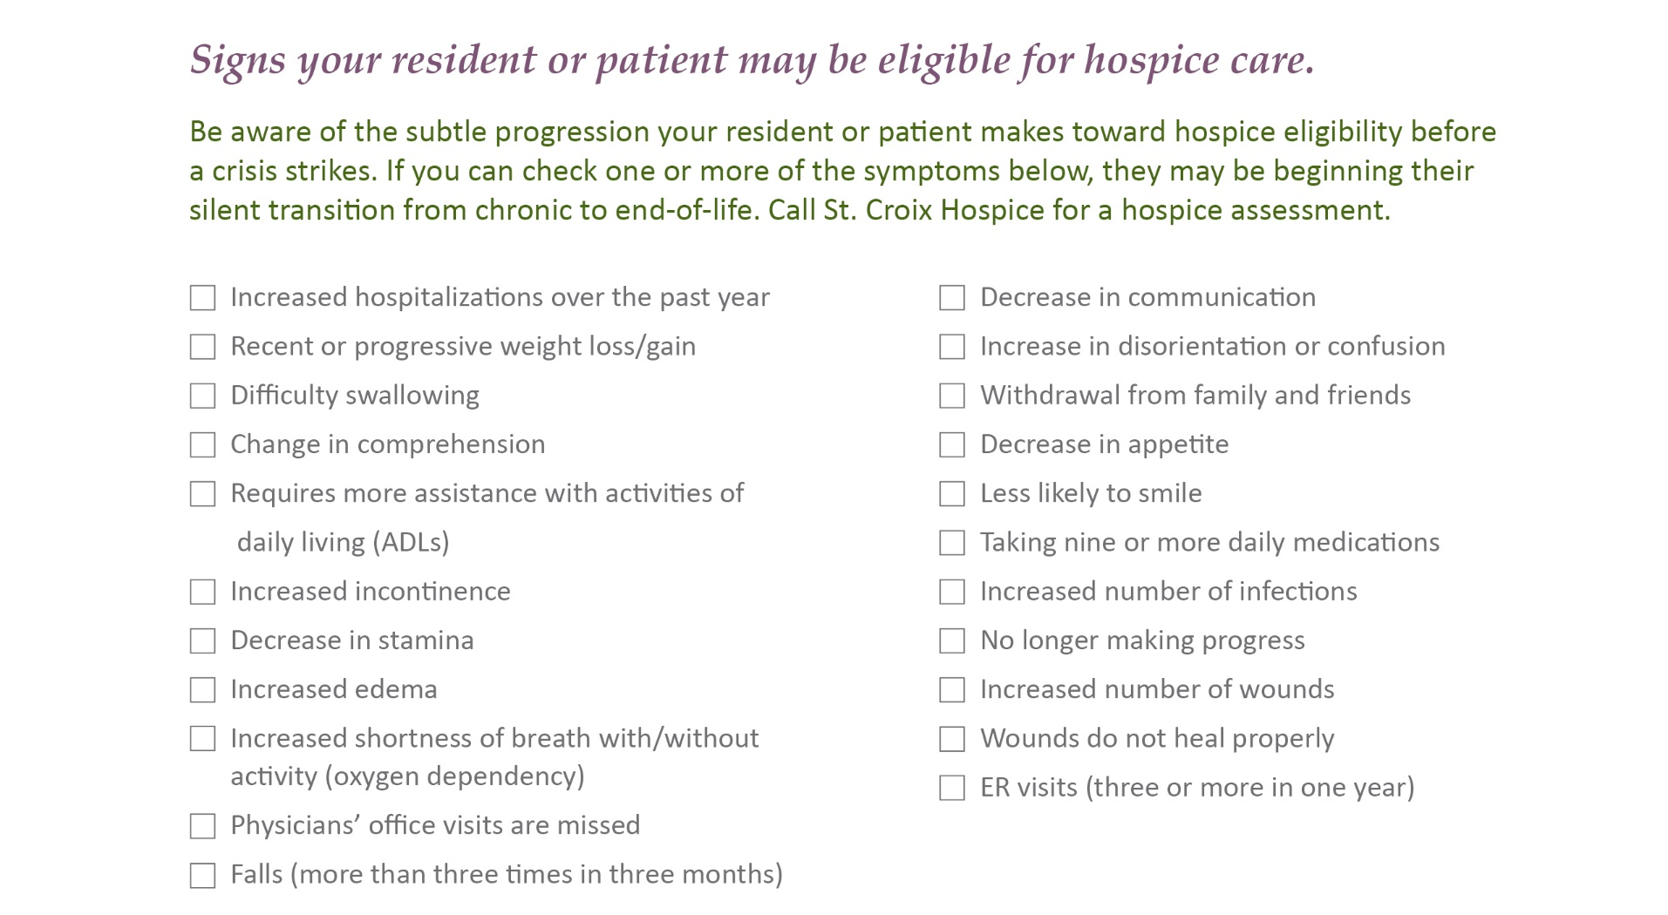
Hospice Eligibility
Notes:
This is our “Silent Transitions” Tool. It lists multiple symptoms and complications that may indicate someone’s health is declining, beginning their transition to becoming hospice appropriate. The more symptoms that are checked off the more likely this person is ready for hospice care.
Read some examples. . . . . Multiple hospitalizations in the past year, recent weight loss or gain, decrease in stamina to name a few.
This Silent Transitions tool is something SCH can provide if anyone is interested in looking at it or using it.

Slide 24
Hospice Myths
Myth:
“My loved one is already receiving care from a facility. What more can hospice do?”
Reality:
Hospice will complement the facility care by providing additional 1:1 care and support for you and your loved one at the end-of-life.
Notes:
In addition – SCH hospice provides 13 months of grief and bereavement support for families. That’s not something the facility is able to provide.
Myth: Only a physician can request a referral for hospice care.
Fact: Anyone can make a hospice referral including: a family member, caregiver, clergy, nurse or the patient themselves.

Slide 25
Hospice Myths
Myth:
“I worry my loved one will die more quickly if signed up for hospice care.”
Reality:
Research shows patients live an average of 29 days longer than patients without hospice care.
Notes:
Hospice neither prolongs or hastens death.
Myth: Hospice Care is available for patients with only days or weeks to live.
Fact: Anyone with a life expectancy of six months or less may begin hospice care. Patients who live longer than six months may continue to be eligible.
While hospice certainly helps patients and families during a medical crisis, the fullest benefit occurs when pain and symptoms are managed and patients have time to make personal and spiritual connections.
Myth: Once you decide on hospice, you can’t go back.
Fact: Patients can revoke hospice participation at any time. Their medical condition may improve or they may decide to pursue curative treatment again. Patients can reapply for care at a later time.

Slide 26
Hospice Myths
Myth:
“My loved one cannot afford to pay for additional health care services.”
Reality:
Hospice is covered by Medicare, Medicaid and most private insurance.
Notes:
Medicare covers virtually all costs associated with hospice care. While there may be a deductible with some private insurances, often times when someone reaches the point of needing hospice care, the deductibles have already been met - hospital stays, tests, etc.
Myth: You cannot see your primary doctor after you begin hospice.
Fact: You may continue to see your primary doctor for as long as you would like; hospice works in partnership with PC physicians.
And finally - Myth: Hospice means giving up hope.
Fact: Hospice does not mean giving up hope. It redefines hope for patients and their families by focusing on maximizing the quality of life, based on the patient’s preferences. Allowing them to make the most of the time they have, living life as fully as possible.

Slide 27
Resources
Standards of a Hospice Program of Care
Journal of Pain and Symptom Management
Hospice Institute of the Florida Suncoast
National Hospice and Palliative Care Organization: www.nhpco.org
Dame Cicely Saunders – St. Christopher's Hospice: www.stchristophers.org
A Perspective on the End of Life: Hospice Care: www.medscape.com
Notes:
Medicare.gov is also helpful.

Slide 28
Questions??
Hospice 101
Notes:
Q & A – Janessa or someone will do this
Thank you for your time and attention today. Our next virtual education is scheduled for February 24 @ 3 pm. The topic is “Hospice 201: Hospice Indicators”. This will be a more in-depth look at different illness, their symptoms and the requirements for each that enable someone to be eligible or appropriate for hospice care.

